Slide 1














FDA Data Capstone
Presented by Asia Larkin
Notes:
Hello everyone. My name is Asia, as you know, and this is my capstone.

Slide 2
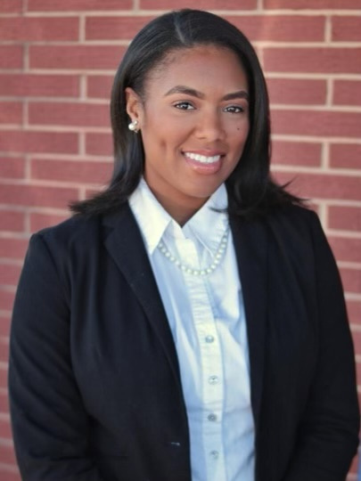
Data Analyst
Asia Larkin
Notes:
Here just a cute photo of me

Slide 3
Data Analysis Process
01
02
03
04
Data Collection
Data Cleaning and Preparation
Data Analysis
Data Sharing
Notes:
To begin, I want to walk you through my process of analyzing this data. I tried to follow a data analysis framework. In my framework, there were only 4 steps:
1. Data Collection
2. Data Cleaning
3. Data Analysis
and
4. Data Sharing (which is what I am doing here with you)

Slide 4
Data Collection
Notes:
Let's start with the data collection process.

Slide 5

Why FDA Data?
The FDA's mission is to protect the public’s health by ensuring the safety of drugs, medical devices, food, cosmetics, and many other products. The FDA strives to advance public health efforts by promoting innovation in response to both deliberate and naturally emerging public health threats.
https://www.fda.gov/about-fda
Notes:
The FDA's mission is to protect the public's health by ensuring the safety of drugs, medical devices, food, cosmetics, and many other products.
As a current public health graduate student and clinical research professional, I thought it would be great to gain some data analytical practice using real-world data from the FDA’s official website.

Slide 6
CAERS Reports
CFSAN Adverse Event Reporting System, or CAERS, is the FDA’s Adverse Event Reporting System. This system plays a crucial role in monitoring the safety of products by collecting and analyzing reports submitted by consumers, healthcare professionals, and manufacturers.
Demographic information
Product information from the case reports
Symptom information from the reports
Patient outcome information from the reports
Notes:
CFSAN Adverse Event Reporting System, or CAERS, is the FDA’s Adverse Event Reporting System. This system plays a crucial role in monitoring the safety of products by collecting and analyzing reports submitted by consumers, healthcare professionals, and manufacturers.
The report includes
- Demographic information
- Product information
- Symptom information
- Patient outcome

Slide 7
Data Cleaning and Preparation
Notes:
Now let's get into the data cleaning and preparation process.

Slide 8



Used Software Applications
Notes:
When cleaning my data I used the following tools:
- I used VSCode to run my Python queries and clean my data
- I also used Python or VSCode to create my visualizations using Matplotlib
- And Canva to create my presentation

Slide 9
Data Analysis
Notes:
Now let's move into the data analysis

Slide 10
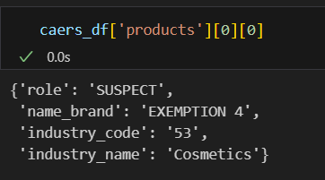
Data Set Insights
Initial Findings:
JSON file - Feb 17th, 2024
1999 - 2024
Almost 950,000 records
Embedded list within columns
For my analysis, I used:
2019 - 2024
283,490 records
Notes:
Here are some insightful things I found during my initial analysis of this data set.
- This data set is offered as JSON file. The FDA website is very insightful when wanting to use their data because they also offer open-source APIs. However, I chose the lesser burn of downloading a JSON file and analyzing that.
I used the data that was shared up to Feb 17th, 2024. In the dataset, it includes reports received by the FDA since 1999. This data set was MASSIVE and included almost a million rows of data. I thought it would be insightful to share that this JSON file also had embedded lists or nested arrays within some columns. Here is a picture of what that looks like just for reference.
For my analysis, I decided to use the reports received by the FDA from 2019 to the current day.

Slide 11
Data Sharing
Notes:
Let's get to the good stuff. The actual findings that I would like to share with you.

Slide 12
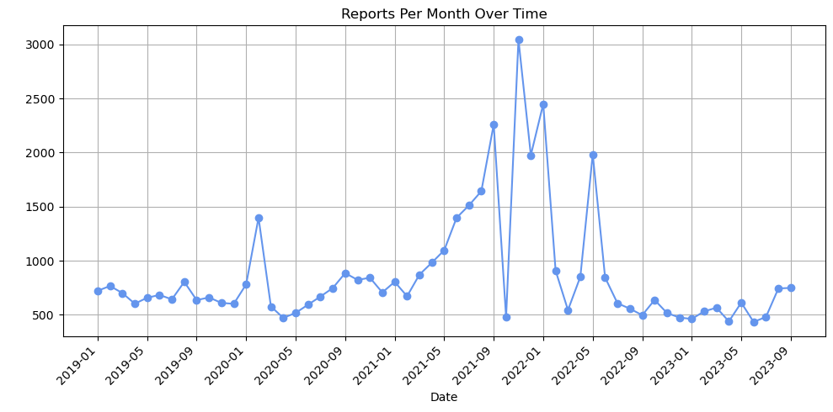
Total Reports
Notes:
As I stated before, the original dataset included reports from 1999. I decided that I wanted to use data from the last 5 years. Here is a visualization of the reports to the FDA since 2019.
The data exhibited a generally stable pattern, showing only occasional spikes. Notably, surges were reported in the months of Feb 2020, Sept 2021, Nov 2021, Jan 2022, and May 2022. The average number of reports per month is 870 reports.
We are going to actually review a few of these spikes today.

Slide 13
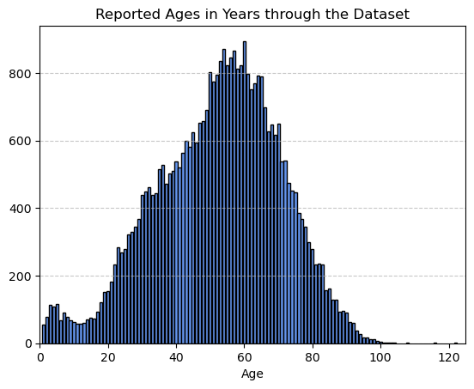
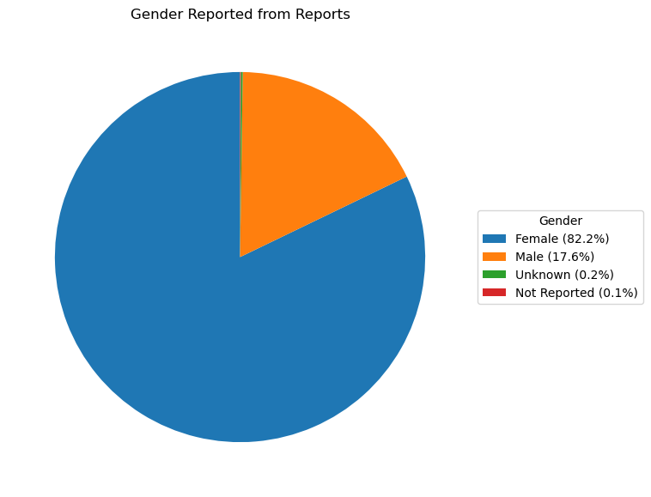
Age and Gender Reported
Notes:
Next, I looked into the demographic data reported.
My dataset had a range of individuals who were under the age of 1 to those who lived to 122!
The majority of ages that were reported were the ages of 53, 54, 56, 57, and 60 years of age.
Top 5 most frequent ages and their counts:
Age: 60.0, Count: 844
Age: 57.0, Count: 832
Age: 54.0, Count: 831
Age: 53.0, Count: 794
Age: 56.0, Count: 793
As you can also see from my pie chart, the majority of reports had affected females with counting for about 82% of the data set.

Slide 14
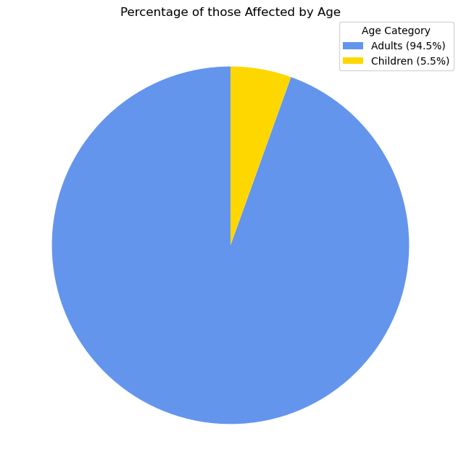
Age Affected by Percentage
Notes:
Age significantly influences patterns within this dataset. As we recognize the significance of self-care, it is equally imperative to prioritize the protection of children.
As per this pie chart, children only made up about 6 percent of the total reports from 2019 to the present day.
Let's take a look at some of those influences.

Slide 15
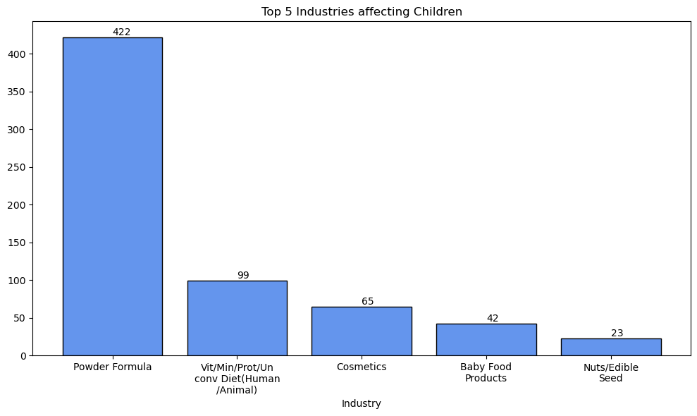
Top 5 Industries Affecting Children
Notes:
Our dataset mentioned many industries that affected children like cereal, milk, bakery goods, and much more. In total, there were 31 different industries that affected children. Here, you can see that powder formula, Human and Animal dietary supplements like vitamins, cosmetics, baby food products, and nuts were among the top 5 industries that were reported in the adverse events.
I decided to drill down on the Powder formula since it topped the list with over 400 reports.

Slide 16
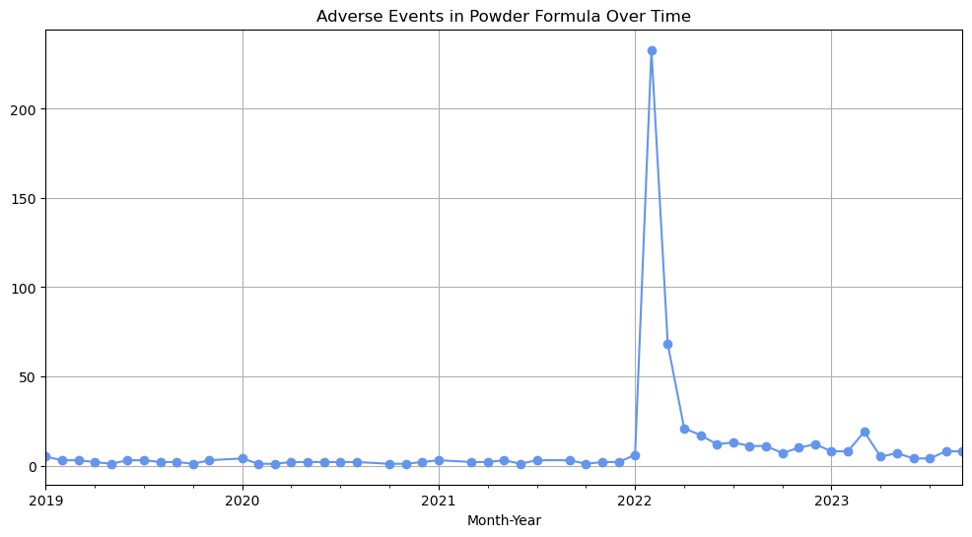
Powder Formula Industry
Notes:
As noted from the line chart, historically, powder formula recalls were almost non-existent over the last 5 years except in 2022.
In February 2022, Abbott Nutrition voluntarily recalled certain lots of Similac, Alimentum, and EleCare powdered infant formulas.
The recall came after the company received five complaints of hospitalized babies with bacterial infections, including two deaths.

Slide 17
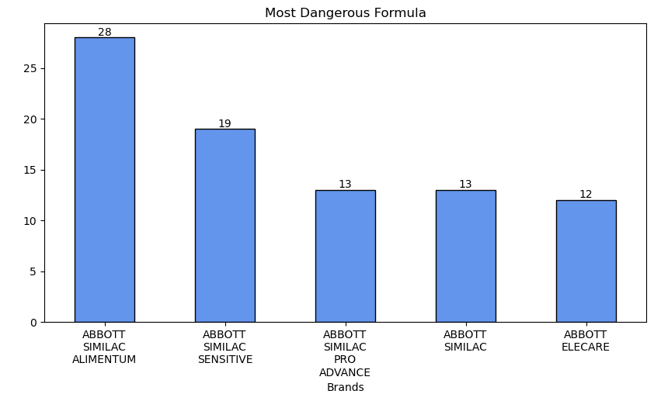
Most Dangerous Powder Formula Brands
Notes:
Abbot Nutrition serves as the overarching brand with various specialized formulas, as evident here. Having worked with the Davidson County WIC program during the recall, witnessing its impact on the public was enlightening. For those unfamiliar, WIC is a federal program offering nutritional aid to low-income pregnant women, new mothers, and young children, with eligibility determined by factors like income and nutritional risk, highlighting the substantial impact of recalls on the public.

Slide 18
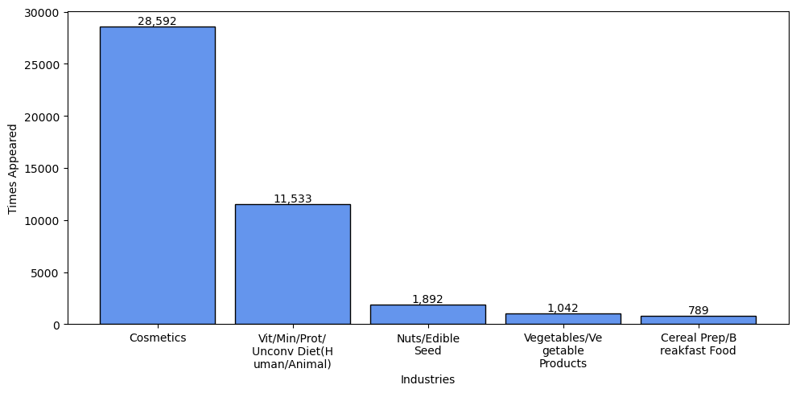
Top 5 Industries with Adverse Events
Notes:
Now, I want to transition and look at where adverse events were concentrated in adults.
Within my data set, there are 44 unique industries. I wanted to drill down on the top 5 since they would have the most reported adverse events.
I was surprised to see that cosmetics made the top spot and were reported more than twice as much as Human and Animal dietary supplements.
Let's drill down a bit further into cosmetics.

Slide 19
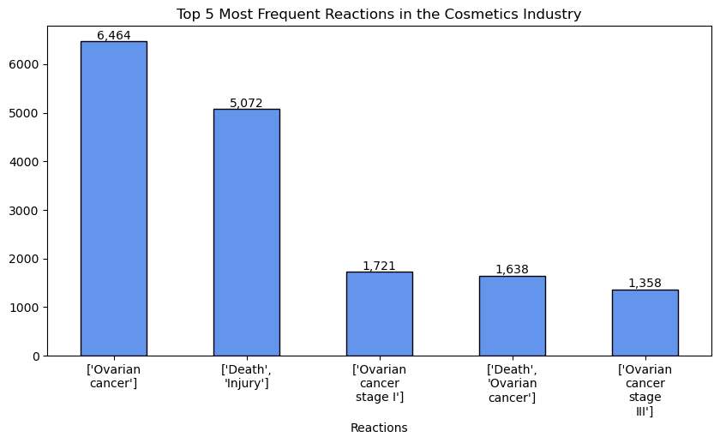
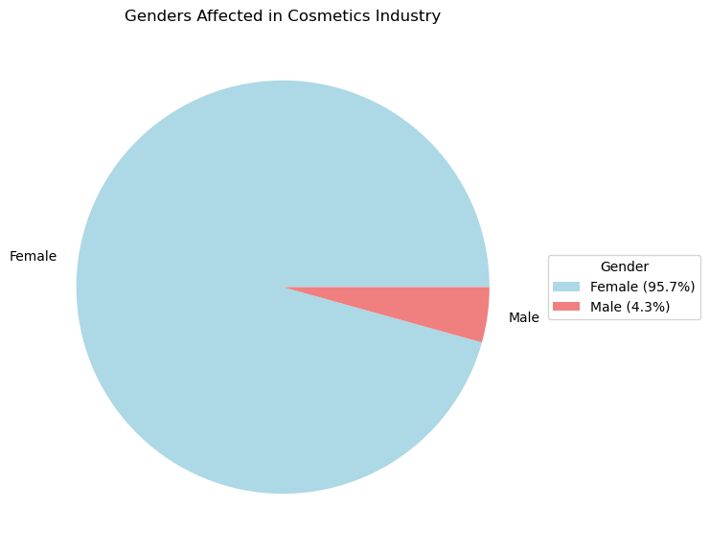
Cosmetic Industry Adverse Events
Notes:
I was interested to know what types of outcomes or adverse events were reported for the reports that were received.
As you can see here, for the Cosmetic Industry, the majority of adverse events were Cancer, Death and Injury, or Death with Cancer.
['Ovarian cancer'] - 6464
['Death', 'Injury'] - 5072
['Ovarian cancer stage I'] - 1721
['Death', 'Ovarian cancer'] - 1638
['Ovarian cancer stage III'] - 1358
Yeah, scary stuff. With ovarian cancer leading the reactions, it did not surprise me to see that 95% of the gender affected by these adverse events were females.
Now, let's see if we can drill down on the brands or products suspected of causing Ovarian Cancer or Death.

Slide 20
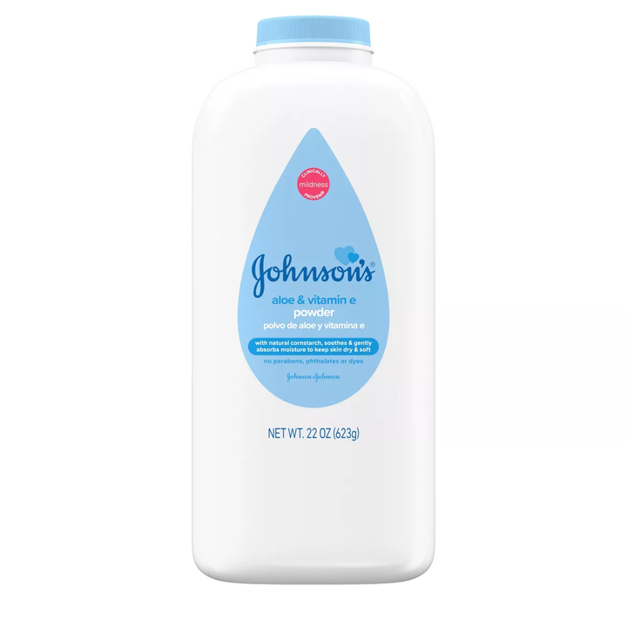
Top 2 Ovarian Cancer Causing
Top 2 Death nd Injury Causing
Exemption 4
Exemption 4
Notes:
For both Ovarian Cancer and Death/Injury combination, Exemption 4 and Johnson's Baby Powder were listed as the top 2.
I know you are probably wondering what Exemption 4 is, and I will explain that shortly.
For those who don't know, since 2019, Johnson and Johnson faced numerous lawsuits related to allegations that its talcum baby powder was linked to ovarian cancer. Plaintiffs claimed that the talc in these products contained asbestos and that long-term use led to the development of ovarian cancer. J&J denied these allegations, asserting that their products were safe and backed by decades of scientific evidence.
However, multiple juries had ruled in favor of plaintiffs, awarding significant damages. The lawsuits raised concerns about product safety, regulatory oversight, and the responsibility of companies to inform consumers about potential risks associated with their products.

Slide 21
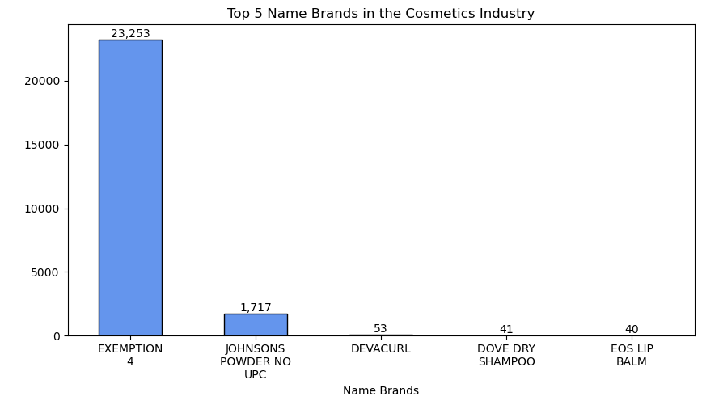
What is exemption 4?
Exemption 4 of the Freedom of Information Act (FOIA) protects trade secrets and commercial or financial information that is privileged or confidential. This exemption is intended to protect the interests of both the government and the submitters of information.
Notes:
Many products chose Exemption 4 of the Freedom of Information Act (FOIA).
This act protects trade secrets and commercial or financial information that is privileged or confidential.
With this exemption, the product's name brand was omitted from being shared. I thought this was a sketchy yet interesting find.
Exemption 4's are the majority of the brand names in my data set as seen from my bar graph.

Slide 22

Conclusions
Notes:
In conclusion, while it's reassuring to have available data for monitoring adverse events, the limitations in the data become apparent when it's not widely known how to report these events. The cosmetic industry spans a broad array of items defined as products designed to be rubbed, poured, sprinkled, sprayed on, or applied to the human body.
Before the onset of lawsuits against Johnson & Johnson in 2019, the company asserted its products' safety based on scientific backing. However, as we now know, this claim was later debunked. It's advisable to avoid talcum-based baby powders and stay informed about recalls through the FDA's official website.

Slide 23
How can I submit a complaint or inquiry?
https://www.fda.gov/food/resources-you-food/industry-and-consumer-assistance-cfsan#report
Notes:
Many of us have experienced an unexpected reaction or adverse event to a product or products we have purchased but do any of us actually know to formally make a complaint? Especially if this is not a one-off and is potentially affecting the lives of many others we would want to know how to make a report.
As complicated as it is in reporting other things in our lives, it seems like it is no easier to report adverse events.
Here, you can find a link for the instructions on how to do so. You can even review current food illness outbreaks.
For your knowledge, there are different ways to report issues with foods, dietary supplements, cosmetics, and even seafood-related illnesses. And even though the FDA regulates other items like tobacco and drugs, there is a totally different area of reporting for those other items.

Slide 24
Thank you very much!
Email asiailarkin@gmail.com for questions

Slide 25
Sources:
Exemption 4 of the Freedom of Information Act (FOIA)
About FDA
FDA open-source APIs
CAERs Data Set
How to report an Adverse Event

